Slide 1
Greedy algorithms

Slide 2
Algorithm Design
To now, we have examined a number of data structures and algorithms to manipulate them
We have seen examples of efficient strategies
Divide and conquer
Binary search
Depth-first tree traversals
Merge sort
Quicksort
Greedy algorithms
Prim’s algorithm
Kruskal’s algorithm
Dijkstra’s algorithm

Slide 3
Greedy algorithms
This topic will cover greedy algorithms:
Definitions
Examples
Making change
Prim’s and Dijkstra’s algorithms
Other examples

Slide 4
Greedy algorithms
Suppose it is possible to build a solution through a sequence of partial solutions
At each step, we focus on one particular partial solution and we attempt to extend that solution
Ultimately, the partial solutions should lead to a feasible solution which is also optimal
Notes:
4

Slide 5





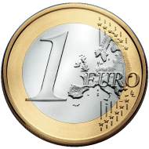

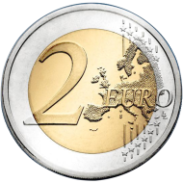
Making change
Consider this commonplace example:
Making the exact change with the minimum number of coins
Consider the Euro denominations of 1, 2, 5, 10, 20, 50 cents
Stating with an empty set of coins, add the largest coin possible into the set which does not go over the required amount
Notes:
5

Slide 6
Making change
Total €0.50
To make change for €0.72:
Start with €0.50
Notes:
6

Slide 7
Making change
Total €0.70
To make change for €0.72:
Start with €0.50
Add a €0.20
Notes:
7

Slide 8
Making change
Total €0.72
To make change for €0.74:
Start with €0.50
Add a €0.20
Skip the €0.10 and the €0. 05 but add a €0.02
Notes:
8

Slide 9
Making change
Notice that each digit can be worked with separately
The maximum number of coins for any digit is three
Thus, to make change for anything less than €1 requires at most six coins
The solution is optimal
Notes:
9

Slide 10
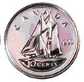
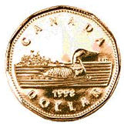
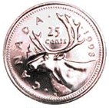



Making change
To make change for 0.72¢ requires six Canadian coins
However, we have only four coins less than $1
This is still, however, optimal

Slide 11
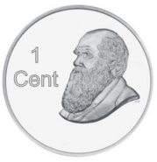


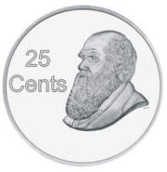
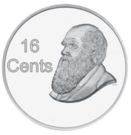


Making change
Reference: J.K. Rowlings, Harry Potter, Raincoast Books, 1997.
Does this strategy always work?
What if our coin denominations grow quadraticly?
Consider 1, 4, 9, 16, 25, 36, and 49 dumbledores

Slide 12
Making change
Using our algorithm, to make change for 72 dumbledores, we require six coins:
72 = 49 + 16 + 4 + 1 + 1 + 1

Slide 13
Making change
The optimal solution, however, is two 36 dumbledore coins

Slide 14
Definition
A greedy algorithm is an algorithm which has:
A set of partial solutions from which a solution is built
An objective function which assigns a value to any partial solution
Then given a partial solution, we
Consider possible extensions of the partial solution
Discard any extensions which are not feasible
Choose that extension which minimizes the object function
This continues until some criteria has been reached

Slide 15
Optimal example
Prim’s algorithm is a greedy algorithm:
Any connected sub-graph of k vertices and k – 1 edges is a partial solution
The value to any partial solution is the sum of the weights of the edges
Then given a partial solution, we
Add that edge which does not create a cycle in the partial solution and which minimizes the increase in the total weight
We continue building the partial solution until the partial solution has n vertices
An optimal solution is found

Slide 16
Optimal example
Dijkstra’s algorithm is a greedy algorithm:
A subset of k vertices and known the minimum distance to all k vertices is a partial solution
Then given a partial solution, we
Add that edge which is smallest which connects a vertex to which the minimum distance is known and a vertex to which the minimum distance is not known
We define the distance to that new vertex to be the distance to the known vertex plus the weight of the connecting edge
We continue building the partial solution until either:
The minimum distance to a specific vertex is known, or
The minimum distance to all vertices is known
An optimal solution is found

Slide 17
Optimal and sub-optimal examples
Our coin change example is greedy:
Any subset of k coins is a partial solution
The value to any partial solution is the sum of the values
Then given a partial solution, we
Add that coin which maximizes the increase in value without going over the target value
We continue building the set of coins until we have reached the target value
An optimal solution is found with euros and cents, but not with our quadratic dumbledore coins
It fails 29 out of 99 times: 12 18 19 22 23 32 41 42 43 48 52 56 61 64 67 68 70 71 72 73 76 77 80 81 88 90 91 92 97

Slide 18
Optimal and sub-optimal examples
An implementation of the greedy algorithm is straight-forward:
void greedy( int value, int *coins, int *rep, int n ) {
for ( int i = n - 1; i >= 0; --i ) {
rep[i] = 0;
while ( coins[i] <= value ) {
value -= coins[i];
++( rep[i] ); //++rep[i] also works
}
}
}

Slide 19
Optimal and sub-optimal examples
Jeffrey Shallit, What this Country Needs is an 18¢ Piece.
Determining whether n denominations of coins will allow a greedy algorithm to minimize change is difficult—there are no easy rules
The Pearson test is an O(n³) algorithm which returns either 0 or a value for which the greedy algorithm fails
int pearson( int *coins, int n ) {
int m = 0, rep1[n], rep2[n];
for ( int j = 0; j < n - 2; ++j ) {
for ( int i = j; i < n - 2; ++i ) {
greedy( coins[i + 1] - 1, coins, rep1, n );
++( rep1[j] );
for ( int k = 0; k < j - 2; ++k ) rep1[k] = 0;
int r = 0; for ( int k = 0; k < n; ++k ) r += rep1[k]*coins[k];
if ( m == 0 || r < m ) {
greedy( r, coins, rep2, n );
int sum1 = 0; for ( int k = 0; k < n; ++k ) sum1 += rep1[k];
int sum2 = 0; for ( int k = 0; k < n; ++k ) sum2 += rep2[k];
if ( sum2 > sum1 ) {
m = r;
}
}
}
}
return m;
}

Slide 20
Unfeasible example
In some cases, it may be possible that not even a feasible solution is found
Consider the following greedy algorithm for solving Sudoku:
For each empty square, starting at the top-left corner and going across:
Fill that square with the smallest number which does not violate any of our conditions
All feasible solutions have equal weight

Slide 21
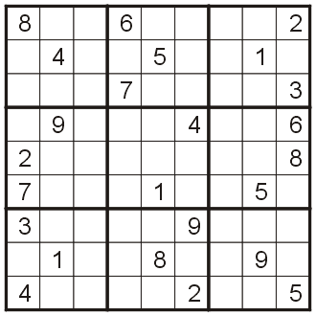
Unfeasible example
Let’s try this example the previously seen Sudoku square:

Slide 22
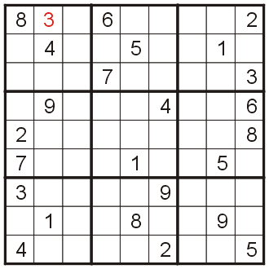
Unfeasible example
Neither 1 nor 2 fits into the first empty square, so we fill it with 3

Slide 23
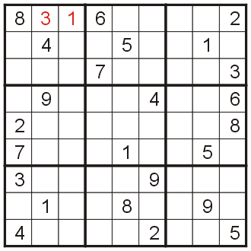
Unfeasible example
The second empty square may be filled with 1

Slide 24
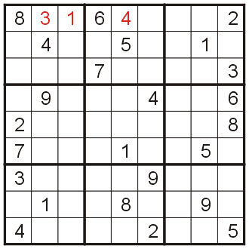
Unfeasible example
And the 3rd empty square may be filled with 4

Slide 25
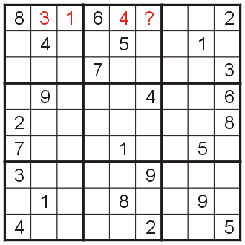
Unfeasible example
At this point, we try to fill in the 4th empty square

Slide 26
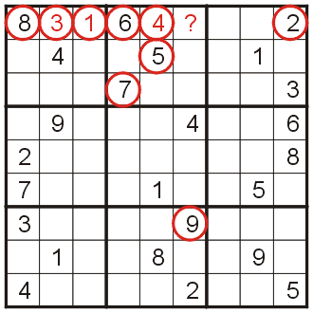
Unfeasible example
Unfortunately, all nine numbers 1 – 9 already appear in such a way to block it from appearing in that square
There is no known greedy algorithm which finds the one feasible solution

Slide 27
Traveling salesman problem
Suppose you want to cycle through n cities without visiting the same city twice
The Traveling Salesman Problem
It is possible to go from any one city to another
The nearest neighbor algorithm is greedy:
Go to the closest city which has not yet been visited
This will find a solution, but it is unlikely to be optimal
Reasonable with Euclidean distances
With random distributions of cities, on average the solution is 125 % of the optimal solution
It can be made to find the worst possible path with constructed examples for non-Euclidean distances

Slide 28
Linear programming
A linear programming program attempts to optimize an n-variables linear objective function subject to constraints on those variables
For example, maximize 3.5x + 4.7y + 6.2z subject to the constraints
4.7x + 2.1y + 3.6z ≤ 6.3
1.9x + 1.4y + 3.1z ≤ 5.1
3.2x + 1.5y ≤ 5.6
9.2x + 4.2z ≤ 8.1
8.2y + 4.5z ≤ 4.7
x ≥ 0
y ≥ 0
z ≥ 0

Slide 29
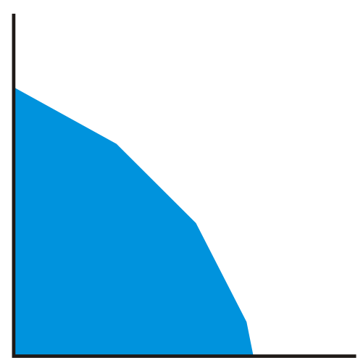
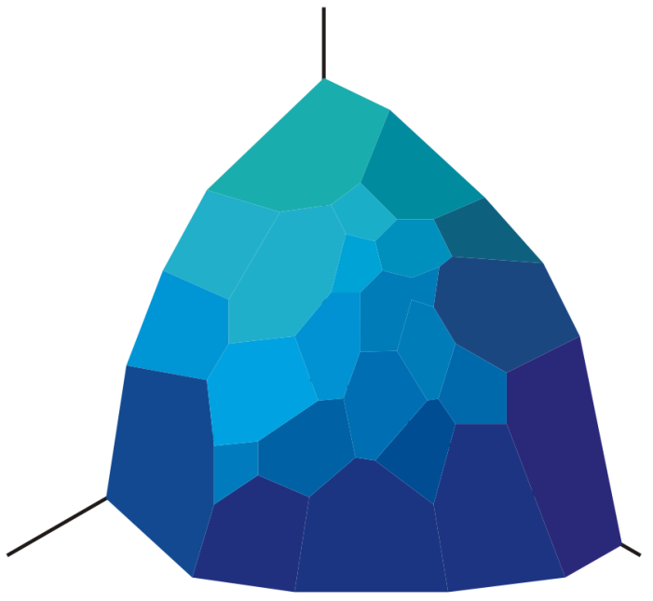
Linear programming
Such linear constraints define polytopes in n-dimensional space
All points within the polytope are feasible
They satisfy all constraints
The point at which the objective function is reached is at a vertex
Four constraints in two variables
Twenty-five constraints in three variables

Slide 30
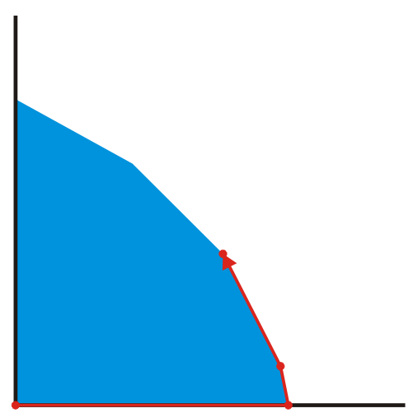
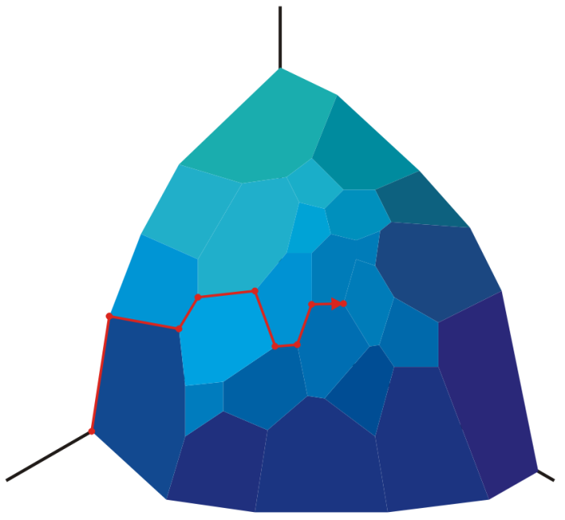
Linear programming
The simplex method starts at a vertex and moves to the adjacent vertex which maximizes the objective function
For most real-world problems, the run time is O(n)
The worst-case scenario is Θ(2^{n})

Slide 31
Optimal substructure
Can we ever prove that a greed algorithm will work efficient?
A problem has an optimal substructure if an optimal solution can be constructed efficiently from optimal solutions of its sub-problems

Slide 32
Near-optimal algorithms
We have seen:
A greedy change algorithm which works under certain conditions
Prim’s and Dijkstra’s algorithms which are greedy and find the optimal solution
A naïve greedy algorithm which attempts (and fails) to solve Sudoku
The nearest neighbor algorithm is unlikely to find the optimal solution
Next, we will see a greedy algorithm which finds a feasible, but not necessarily an optimal, solution
Notes:
32

Slide 33
Project management 0/1 knapsack problem
Situation:
The next cycle for a given product is 26 weeks
We have ten possible projects which could be completed in that time, each with an expected number of weeks to complete the project and an expected increase in revenue
This is also called the 0/1 knapsack problem
You can place n items in a knapsack where each item has a value in rupees and a weight in kilograms
The knapsack can hold a maximum of m kilograms

Slide 34

Project management 0/1 knapsack problem
Objective:
As project manager, choose those projects which can be completed in the required amount of time which maximizes revenue
Maplesoft’s most-cool project manager

Slide 35
Project management 0/1 knapsack problem
The projects:
Product ID | Completion Time (wks) | Expected Revenue (1000 $)
A | 15 | 210
B | 12 | 220
C | 10 | 180
D | 9 | 120
E | 8 | 160
F | 7 | 170
G | 5 | 90
H | 4 | 40
J | 3 | 60
K | 1 | 10

Slide 36
Project management 0/1 knapsack problem
Let us first try to find an optimal schedule by trying to be as productive as possible during the 26 weeks:
we will start with the projects in order from most time to least time, and at each step, select the longest-running project which does not put us over 26 weeks
we will be able to fill in the gaps with the smaller projects

Slide 37
Project management 0/1 knapsack problem
Greedy-by-time (make use of all 26 wks):
Project A: 15 wks
Project C: 10 wks
Project J: 1 wk
Total time: 26 wks
Expected revenue:
$400 000
Product ID | Completion Time (wks) | Expected Revenue (1000 $)
A | 15 | 210
B | 12 | 220
C | 10 | 180
D | 9 | 120
E | 8 | 160
F | 7 | 170
G | 5 | 90
H | 4 | 40
I | 3 | 60
J | 1 | 10

Slide 38
Project management 0/1 knapsack problem
Next, let us attempt to find an optimal schedule by starting with the most :
we will start with the projects in order from most time to least time, and at each step, select the longest-running project which does not put us over 26 weeks
we will be able to fill in the gaps with the smaller projects

Slide 39
Project management 0/1 knapsack problem
Greedy-by-revenue (best-paying projects):
Project B: $220K
Project C: $180K
Project H: $ 60K
Project K: $ 10K
Total time: 26 wks
Expected revenue:
$470 000
Product ID | Completion Time (wks) | Expected Revenue (1000 $)
B | 12 | 220
A | 15 | 210
C | 10 | 180
F | 7 | 170
E | 8 | 160
D | 9 | 120
G | 5 | 90
J | 3 | 60
H | 4 | 40
K | 1 | 10

Slide 40
Project management 0/1 knapsack problem
Unfortunately, either of these techniques focuses on projects which have high projected revenues or high run times
What we really want is to be able to complete those jobs which pay the most per unit of development time
Thus, rather than using development time or revenue, let us calculate the expected revenue per week of development time

Slide 41
Project management 0/1 knapsack problem
This is summarized here:
Product ID | Completion Time (wks) | Expected Revenue (1000 $) | Revenue Density ($ / wk)
A | 15 | 210 | 14 000
B | 12 | 220 | 18 333
C | 10 | 180 | 18 000
D | 9 | 120 | 13 333
E | 8 | 160 | 20 000
F | 7 | 170 | 24 286
G | 5 | 90 | 18 000
H | 4 | 40 | 10 000
J | 3 | 60 | 20 000
K | 1 | 10 | 10 000

Slide 42
Project management 0/1 knapsack problem
Greedy-by-revenue-density:
Project F: $24 286/wk
Project E: $20 000/wk
Project J: $20 000/wk
Project G: $18 000/wk
Project K: $10 000/wk
Total time: 24 wks
Expected revenue:
$490 000
Bonus: 2 weeks for bug fixing
Product ID | Completion Time (wks) | Expected Revenue (1000 $) | Revenue Density ($/wk)
F | 7 | 170 | 24 286
E | 8 | 160 | 20 000
J | 3 | 60 | 20 000
B | 12 | 220 | 18 333
C | 10 | 180 | 18 000
G | 5 | 90 | 18 000
A | 15 | 210 | 14 000
D | 9 | 120 | 13 333
H | 4 | 40 | 10 000
K | 1 | 10 | 10 000

Slide 43
Project management 0/1 knapsack problem
Using brute force, we find that the optimal solution is:
Project C: $180 000
Project E: $170 000
Project F: $150 000
Project K: $ 10 000
Total time: 26 wks
Expected revenue:
$520 000
Product ID | Completion Time (wks) | Expected Revenue (1000 $) | Revenue Density ($/wk)
A | 15 | 210 | 14 000
B | 12 | 220 | 18 333
C | 10 | 180 | 18 000
D | 9 | 120 | 13 333
E | 8 | 160 | 20 000
F | 7 | 170 | 24 286
G | 5 | 90 | 18 000
H | 4 | 40 | 10 000
J | 3 | 60 | 20 000
K | 1 | 10 | 10 000

Slide 44
Project management 0/1 knapsack problem
In this case, the greedy-by-revenue-density came closest to the optimal solution:
The run time is Θ(n ln(n)) — the time required to sort the list
Later, we will see a dynamic program for finding an optimal solution with one additional constraint
Algorithm | Expected Revenue
Greedy-by-time | $400 000
Greedy-by-expected revenue | $470 000
Greedy-by-revenue density | $490 000
Brute force | $520 000

Slide 45
Project management 0/1 knapsack problem
Of course, in reality, there are numerous other factors affecting projects, including:
Flexible deadlines (if a delay by a week would result in a significant increase in expected revenue, this would be acceptable)
Probability of success for particular projects
The requirement for banner projects
Note that greedy-by-revenue-density had none of the larger projects
To demonstrate that this works in general, an implementation exists at:
http://ece.uwaterloo.ca/~ece250/Algorithms/Project_scheduling/

Slide 46
Process scheduling
The primary resource in any computer is the processing unit
One process (a running program) can run on a processor at any one time
single process—single processor
multiple processes—single processor
multiple processes—multiple processors
multiple threads—single, multiple, or multicore processors

Slide 47
Process scheduling
Multiprogramming
running processes in batches
Cooperative multitasking/time-sharing
processes voluntarily (through a system command) give up the processor
this requires careful programming...good luck!
some of you may remember Windows 3.1

Slide 48
Process scheduling
Preemptive multitasking/time-sharing
the operating system controls access to the processor
processes may be preempted (time slices, interrupts)
Real Time
addition of priorities, guarantees, etc.

Slide 49
Process scheduling
Suppose we have N processes with known run times which are scheduled to run on a single processor
This may occur either:
in an embedded system where the system is known before-hand, or
from past runs, the average processor usage has been tracked
Suppose we want to minimize the total wait time for the processes to complete

Slide 50
Process scheduling
Consider the following processes:
Ref: Weiss, DS&AA in C++, 2nd Ed., p.410
Process (i) | Time (t_{i})
1 | 15 ms
2 | 8 ms
3 | 3 ms
4 | 10 ms

Slide 51
Process scheduling
If we scheduled them according to process number, we would get the following schedule:
The total wait time is
15 + 23 + 26 + 36 = 100 ms

Slide 52
Process scheduling
This is not the optimal schedule
If instead we choose a greedy algorithm which chooses the process with the shortest run time next, we get:
The total wait time is
3 + 11 + 21 + 36 = 71 ms

Slide 53
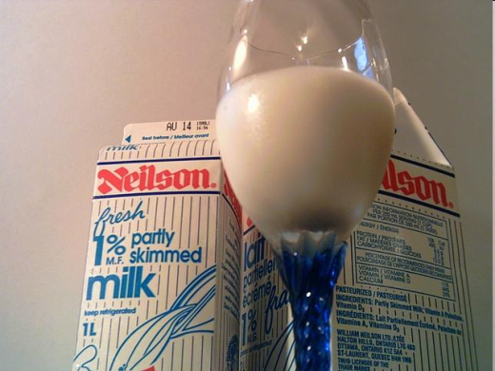
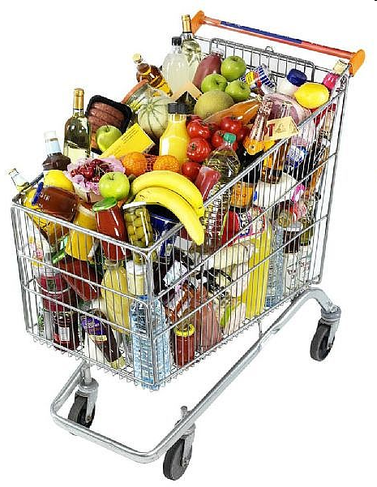
Process scheduling
http://www.ehow.com/
Intuitively, you know the answer:
You have 1 L of milk
30 s to ring it in and pay
Another person has a full cart
10 min to ring it in and pay
If they go first, they wait 10:00 and you wait 10:30
Total wait time: 20:30
If you go first, you wait 0:30 and they wait 10:30
Total wait time: 11:00
Notes:
53

Slide 54
Process scheduling
In this case, the greedy solution provides the optimal solution
We can show this mathematically
Let i₁, i₂, i₃, i₄ be a permutation of the process numbers {1, 2, 3, 4}
For example, if we order the processes 3, 1, 4, 2 then
i₁ = 3, i₂ = 1, i₃ = 4, and i₄ = 2
and and

Slide 55
Process scheduling
The process time for each of the processes is summarized in this table:
Process | Time
i₁
i₂
i₃
i₄
Sum

Slide 56
Process scheduling
We can write this sum for an arbitrary number of processes N as:
which can be expanded into
This is constant
This may change:
3 × 7 + 4 × 5 < 3 × 5 + 4 × 7

Slide 57
Process scheduling
To minimize the total wait time, we must maximize
Choose any two and consider
The first term does not depend on the order of or , but the second does
(k – j) > 0 and to maximize the second term, we require
Thus must be true for all pairs, thus

Slide 58
Process scheduling
To quickly demonstrate this, suppose we take the two processes with times 8.4 and 10.7 ms
2·10.7 ms + 3·8.4 ms = 46.6 ms 2·8.4 ms + 3·10.7 ms = 48.9 ms
Thus, the optimal ordering must be shortest-process first
This same result holds if we have multiple processors:
If we want to schedule N processes on M processors, if we want to minimize the total wait time, we order the processes from shortest completion time to longest and schedule them cyclically
Notes:
58

Slide 59
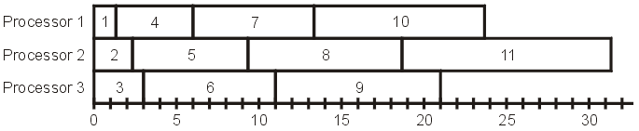
Process scheduling
For example, given 12 processes and three processors, we could schedule the processes as follows:

Slide 60
Process scheduling
One problem which cannot be solved using a greedy algorithm is minimizing the final completion time:
given N processes, minimize the overall time required to complete all processes
This is in a class of problems termed NP-complete, which we will look at later

Slide 61
Process scheduling
For example, consider the processes and completion times listed in this table
Suppose we can run these processes on three different processors (assuming that the processes are not interdependent)
Process | Time (ms)
1 | 3
2 | 5
3 | 6
4 | 10
5 | 11
6 | 14
7 | 15
8 | 18
9 | 20

Slide 62
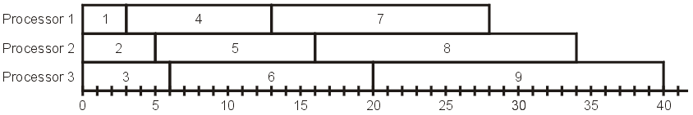
Process scheduling
Minimizing the average wait time, we assign the processes cyclically:
The total wait time is 156 ms and therefore the average wait time is 156 ms/9 = 17.333 ms

Slide 63
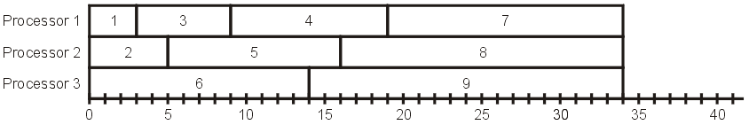
Process scheduling
Suppose, however, we want to minimize the final completion time, we require:
The total wait time is longer:
168 ms versus 156 ms
This is a difficult (NP-complete) problem (2nd-last topic)

Slide 64
Process scheduling
Scheduling processes is covered in greater detail in ECE 254 Operating Systems and Systems Programming
This will include numerous other (often greedy) schemes for scheduling as well as preemptive multitasking and real-time constraints

Slide 65
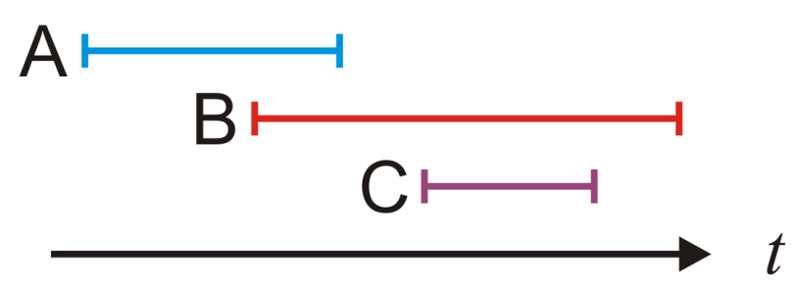
Interval scheduling
Suppose we have a list of processes, each of which must run in a given time interval:
e.g., process A must run during 2:00-5:00 process B must run during 4:00-9:00 process C must run during 6:00-8:00
Clearly, not all three processes can be run
Applications in ECE 254 Operating Systems and Systems Programming

Slide 66
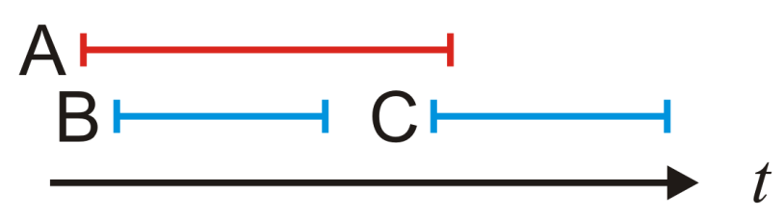
Interval scheduling
Suppose we want to maximize the number of processes that are run
In order to create a greedy algorithm, we must have a fast selection process which quickly determines which process should be run next
The first thought may be to always run that process that is next ready to run
A little thought, however, quickly demonstrates that this fails
The worst case would be to only run 1 out of n possible processes when n – 1 processes could have been run

Slide 67
Interval scheduling
To maximize the number of processes that are run, we should trying to free up the processor as quickly as possible
Instead of looking at the start times, look at the end times
At any time that the processor is available, select that process with the earliest end time: the earliest-deadline-first algorithm
In this example, Process B is the first to start, and then Process C follows:

Slide 68
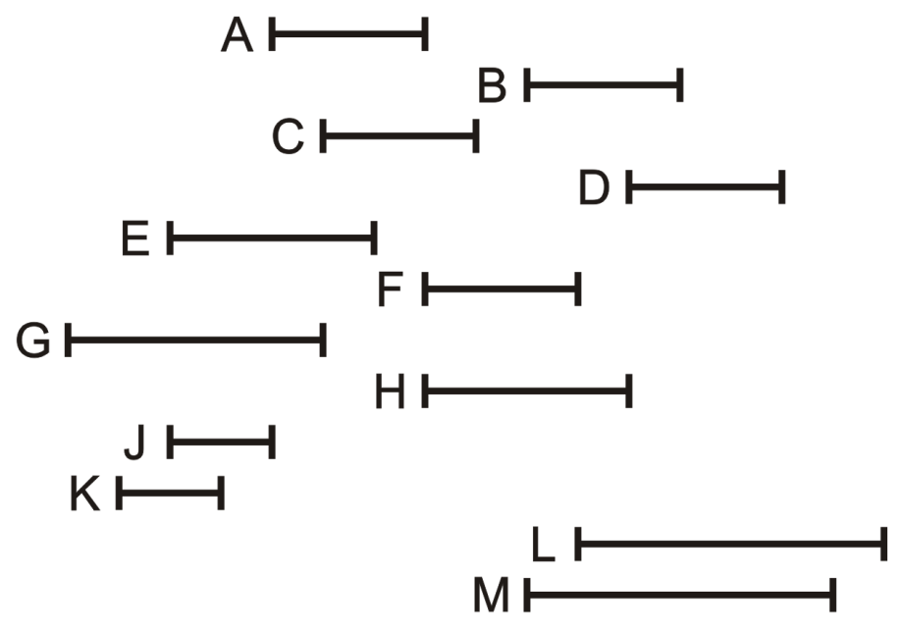
Interval scheduling
Process | Interval
A | 5 – 8
B | 10 – 13
C | 6 – 9
D | 12 – 15
E | 3 – 7
F | 8 – 11
G | 1 – 6
H | 8 – 12
J | 3 – 5
K | 2 – 4
L | 11 – 16
M | 10 – 15
Consider the following list of 12 processes together with the time interval during which they must be run
Find the optimal schedule with the earliest- deadline-first greedy algorithm

Slide 69
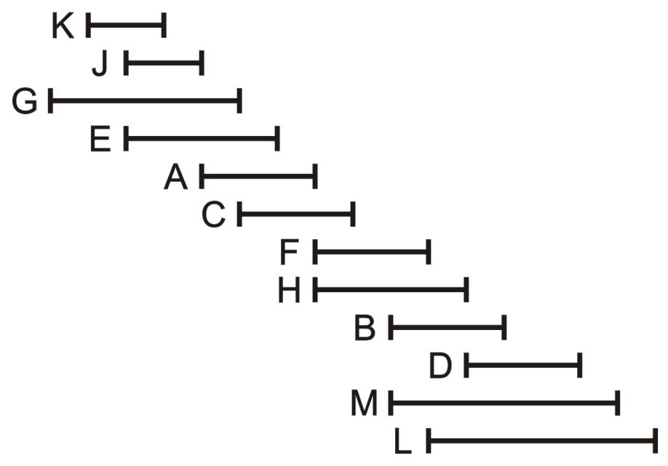
Interval scheduling
Process | Interval
K | 2 – 4
J | 3 – 5
G | 1 – 6
E | 3 – 7
A | 5 – 8
C | 6 – 9
F | 8 – 11
H | 8 – 12
B | 10 – 13
D | 12 – 15
M | 10 – 15
L | 11 – 16
In order to simplify this, sort the processes on their end times

Slide 70
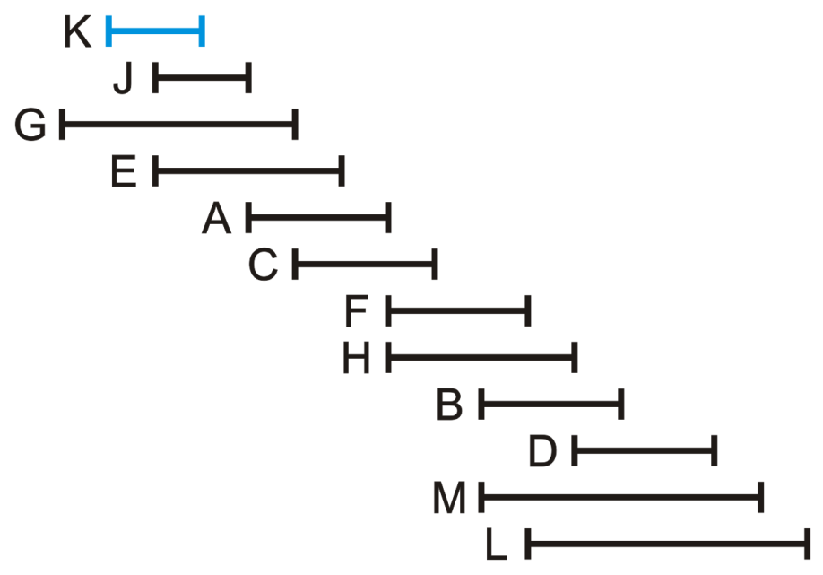
Interval scheduling
Process | Interval
K | 2 – 4
J | 3 – 5
G | 1 – 6
E | 3 – 7
A | 5 – 8
C | 6 – 9
F | 8 – 11
H | 8 – 12
B | 10 – 13
D | 12 – 15
M | 10 – 15
L | 11 – 16
To begin, choose Process K

Slide 71
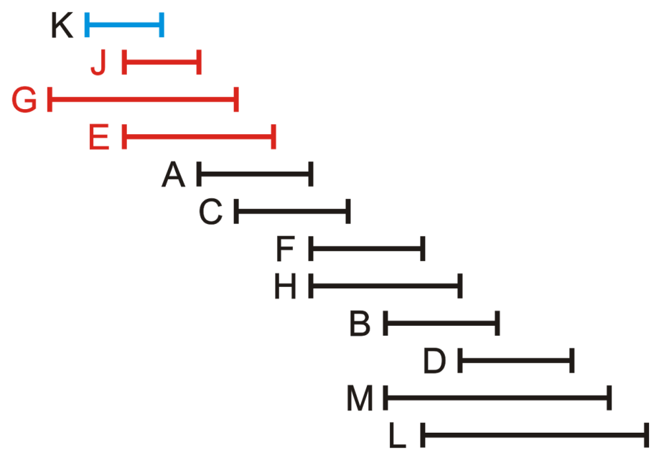
Interval scheduling
Process | Interval
K | 2 – 4
J | 3 – 5
G | 1 – 6
E | 3 – 7
A | 5 – 8
C | 6 – 9
F | 8 – 11
H | 8 – 12
B | 10 – 13
D | 12 – 15
M | 10 – 15
L | 11 – 16
At this point, Process J, G and E can no longer be run

Slide 72
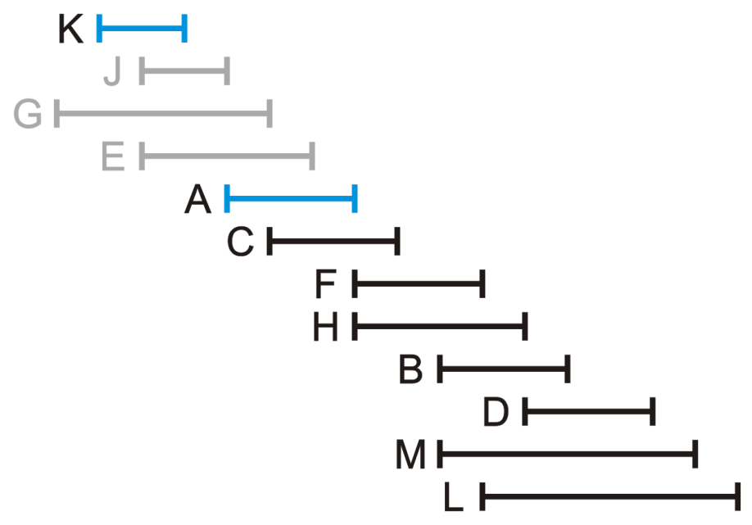
Interval scheduling
Process | Interval
K | 2 – 4
J | 3 – 5
G | 1 – 6
E | 3 – 7
A | 5 – 8
C | 6 – 9
F | 8 – 11
H | 8 – 12
B | 10 – 13
D | 12 – 15
M | 10 – 15
L | 11 – 16
Next, run Process A

Slide 73
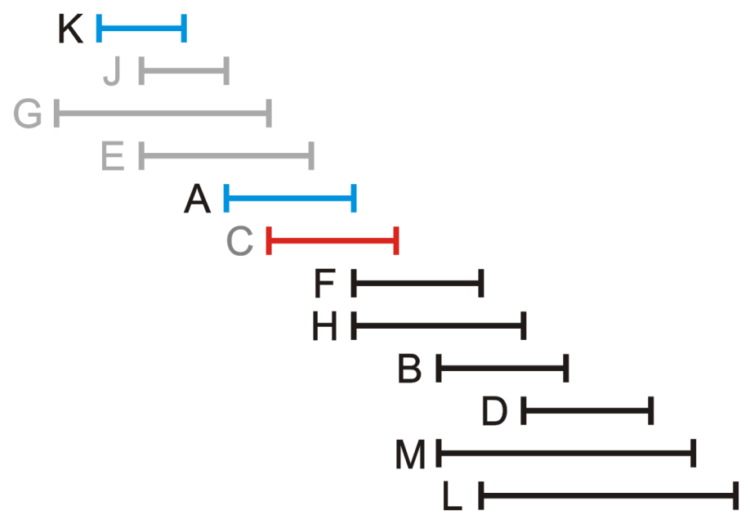
Interval scheduling
Process | Interval
K | 2 – 4
J | 3 – 5
G | 1 – 6
E | 3 – 7
A | 5 – 8
C | 6 – 9
F | 8 – 11
H | 8 – 12
B | 10 – 13
D | 12 – 15
M | 10 – 15
L | 11 – 16
We can no longer run Process C

Slide 74
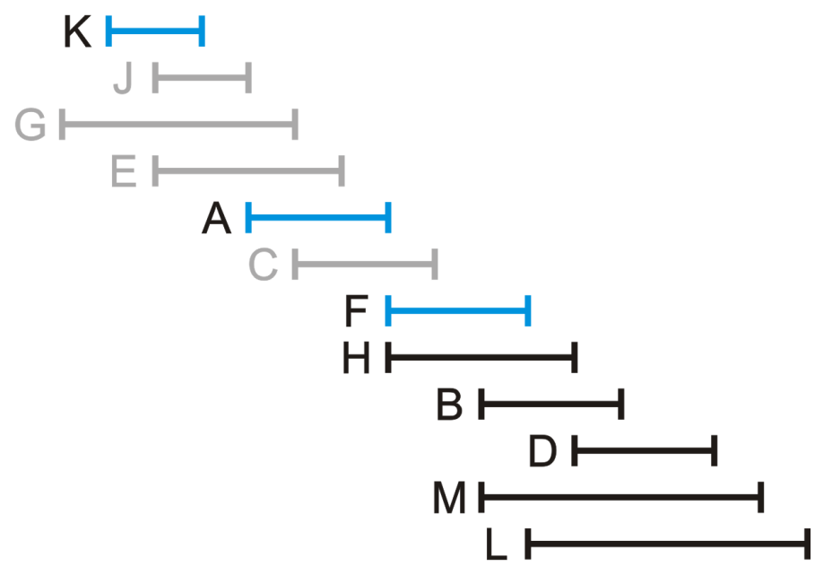
Interval scheduling
Process | Interval
K | 2 – 4
J | 3 – 5
G | 1 – 6
E | 3 – 7
A | 5 – 8
C | 6 – 9
F | 8 – 11
H | 8 – 12
B | 10 – 13
D | 12 – 15
M | 10 – 15
L | 11 – 16
Next, we can run Process F

Slide 75
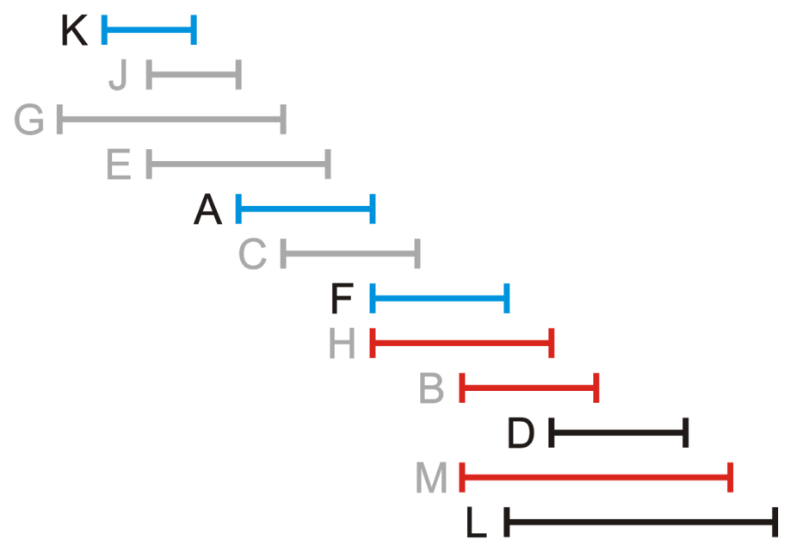
Interval scheduling
Process | Interval
K | 2 – 4
J | 3 – 5
G | 1 – 6
E | 3 – 7
A | 5 – 8
C | 6 – 9
F | 8 – 11
H | 8 – 12
B | 10 – 13
D | 12 – 15
M | 10 – 15
L | 11 – 16
This restricts us from running Processes H, B and M

Slide 76
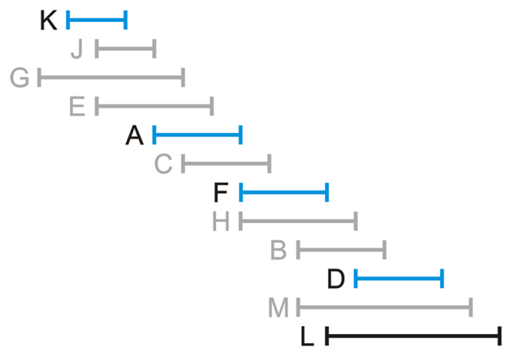
Interval scheduling
Process | Interval
K | 2 – 4
J | 3 – 5
G | 1 – 6
E | 3 – 7
A | 5 – 8
C | 6 – 9
F | 8 – 11
H | 8 – 12
B | 10 – 13
D | 12 – 15
M | 10 – 15
L | 11 – 16
The next available process is D

Slide 77
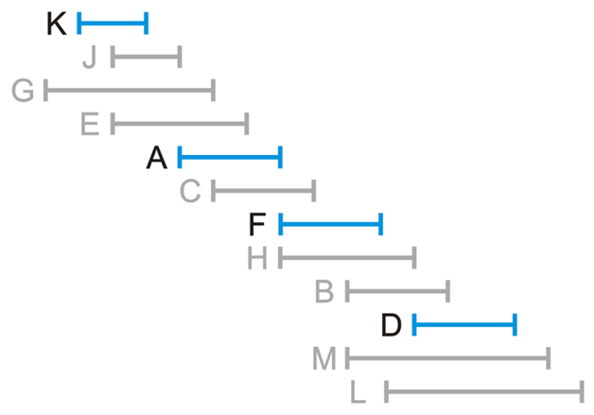
Interval scheduling
Process | Interval
K | 2 – 4
J | 3 – 5
G | 1 – 6
E | 3 – 7
A | 5 – 8
C | 6 – 9
F | 8 – 11
H | 8 – 12
B | 10 – 13
D | 12 – 15
M | 10 – 15
L | 11 – 16
The prevents us from running Process L
We are therefore finished

Slide 78
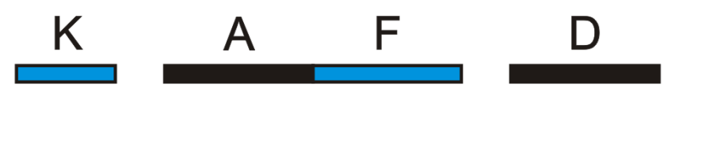
Application: Interval scheduling
Process | Interval
K | 2 – 4
J | 3 – 5
G | 1 – 6
E | 3 – 7
A | 5 – 8
C | 6 – 9
F | 8 – 11
H | 8 – 12
B | 10 – 13
D | 12 – 15
M | 10 – 15
L | 11 – 16
We have scheduled four processes
The selection may not be unique
Once the processes are sorted, the run time is linear—we simply look ahead to find the next process that can be run
Thus, the run time is the run time of sorting the

Slide 79
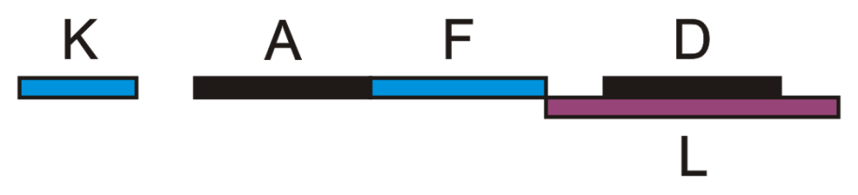
Application: Interval scheduling
Process | Interval
K | 2 – 4
J | 3 – 5
G | 1 – 6
E | 3 – 7
A | 5 – 8
C | 6 – 9
F | 8 – 11
H | 8 – 12
B | 10 – 13
D | 12 – 15
M | 10 – 15
L | 11 – 16
For example, we could have chosen Process L
In this case, processor usage would go up, but no significance is given to that criteria

Slide 80
Application: Interval scheduling
Process | Interval
K | 2 – 4
J | 3 – 5
G | 1 – 6
E | 3 – 7
A | 5 – 8
C | 6 – 9
F | 8 – 11
H | 8 – 12
B | 10 – 13
D | 12 – 15
M | 10 – 15
L | 11 – 16
We could add weights to the individual processes
The weights could be the duration of the processes—maximize processor usage
The weights could be revenue gained from the performance—maximize revenue
We will see an efficient algorithm in the topic on dynamic programming

Slide 81
Summary
We have seen the algorithm-design technique, namely greedy algorithms
For some problems, appropriately-designed greedy algorithms may find either optimal or near-optimal solutions
For other problems, greedy algorithms may a poor result or even no result at all
Their desirable characteristic is speed

Slide 82
References
Wikipedia, http://en.wikipedia.org/wiki/Algorithm_design
These slides are provided for the ECE 250 Algorithms and Data Structures course. The material in it reflects Douglas W. Harder’s best judgment in light of the information available to him at the time of preparation. Any reliance on these course slides by any party for any other purpose are the responsibility of such parties. Douglas W. Harder accepts no responsibility for damages, if any, suffered by any party as a result of decisions made or actions based on these course slides for any other purpose than that for which it was intended.

